Slide 1
Better in 2024!
Discovering (or Remembering) Insights and Practices Linked to Human Thriving
Wellness Wednesday 1-17-2024
Mr. Charlie Coiro – USCG Leadership Development Center
Notes:
Good afternoon, Shipmates
Embark on a journey of personal growth in 2024! Join Mr. Charlie Coiro from the Coast Guard's Leadership Development Center as he delves into the realm of Positive Psychology. Discover insights and practices linked to human thriving, drawing from the wisdom of influential thinkers in this field. Mr. Coiro will not only present key concepts but also encourage participants to contribute their own best practices for fostering well-being both at home and in the workplace. It's an opportunity to explore and share ways to flourish in various aspects of life.
**Please note this is a new URL - Wellness Wednesday is being hosted on the below CG Teams site from 1500-1600 ET.**
https://dod.teams.microsoft.us/l/meetup-join/19%3adod%3ameeting_8cc5cb90fd1a44ad8f7313f4f3095afb%40thread.v2/0?context=%7b%22Tid%22%3a%22369ba0d5-02cb-4d2f-94fd-9212cc24b78c%22%2c%22Oid%22%3a%22adc478d8-ca49-4c6c-b614-f5ce75cb132a%22%7d
If you cannot access the sessions, you may call-in via the phone bridge: +1 410-874-6742, Conference ID: 646-365-62# **
If you have questions or suggestions, you may e-mail us at wellnesswednesday@uscg.mil. Wellness Wednesday recordings are available on the CG-111 Health Promotion Website: Health Promotion Resources | Office of Work-Life Programs (CG-111) (uscg.mil)
** If you know someone in need of support, please connect them with Suicide & Crisis Lifeline by dialing or texting 988 from any phone. The line is available 7 days a week/24 hour a day**
Semper Paratus et Semper Salutaris!
On behalf of RADM Dana Thomas
Chief Medical Officer
CAPT Carrie Wolfe (She/her)
Chief, Office of Work-Life Programs (CG-1K1)
Office Location: 9CC21-02

Slide 2
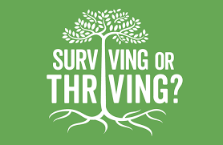
Agenda
Wisdom of the Ages
Positive Psychology
Concepts and Mindsets
Habits
Examples
Notes:
What is Seligman's theory of happiness?
This vision of happiness combines the virtue ethics of Confucius, Mencius and Aristotle with modern psychological theories of motivation. Seligman's conclusion is that happiness has three dimensions that can be cultivated: the Pleasant Life, the Good Life, and the Meaningful Life.
https://www.pursuit-of-happiness.org/history-of-happiness/martin-seligman-psychology/
Seligman Flourish and Perma explanatory style VIA Emails.
Epictetus
Brooks Arthur and David
Podcasts - Yale Russo
Habits - Rubin
Single tasking - Flow
Balance (Wheel) imbalance at the right time.
Book Summary Build the Life you want:
That means creating four sturdy pillars that will elevate you, every single day. What are those pillars? Family, friends, meaningful work, and spirituality.
What makes humans thrive
Human thriving often involves a combination of factors such as strong social connections, a sense of purpose, good physical and mental health, and opportunities for personal growth. It varies for each individual.
Thriving individuals often cultivate habits like maintaining a healthy routine, setting goals, practicing gratitude, engaging in regular exercise, fostering positive relationships, seeking personal development, and prioritizing self-care. These habits contribute to a balanced and fulfilling life.
An effective morning routine for thriving usually includes elements like:
Early Wake-up: Providing ample time for a calm start.
Hydration: Drinking water to rehydrate after sleep.
Physical Activity: Incorporating exercise for energy and well-being.
Mindfulness or Meditation: Promoting mental clarity and focus.
Nutritious Breakfast: Fueling the body with a balanced meal.
Goal Setting: Planning tasks for the day ahead.
Positive Affirmations: Cultivating a positive mindset.
Learning or Reading: Stimulating the mind with new information.
Customizing these components based on personal preferences and priorities can enhance the effectiveness of the morning routine.
What is human thriving?
Specifically, human thriving was defined as the joint experience of development and success, which can be realized through effective holistic functioning and observed through the experience of a high-level of well-being and a perceived high-level of performance.
How does a person thrive?
The strength with the most immediate resonance would be perseverance–the capacity to keep going, to overcome obstacles. Other important strengths include hope, gratitude, forgiveness, spirituality, curiosity, and kindness

Slide 3
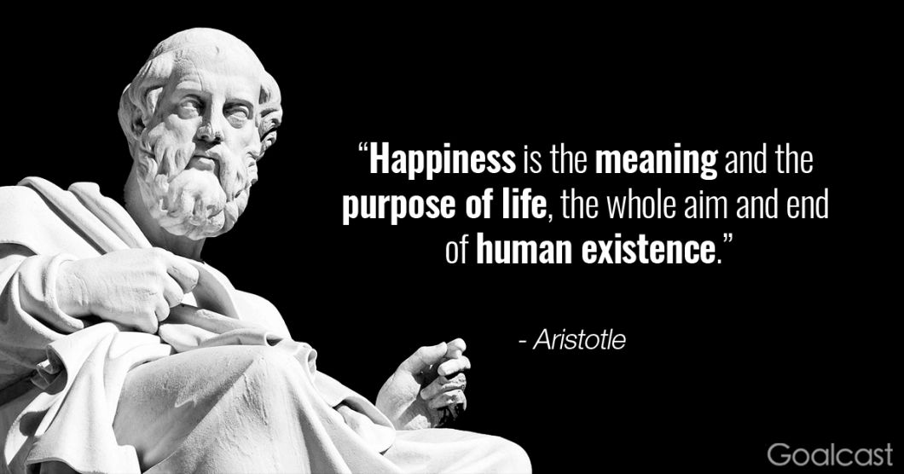
Notes:
What is the good life according to Aristotle?
According to Aristotle, the good life is the happy life, as he believes happiness is an end in itself. In the Nichomachean Ethics, Aristotle develops a theory of the good life, also known as eudaimonia, for humans. Eudaimonia is perhaps best translated as flourishing or living well and doing well.
Plato's student, Aristotle, had a different notion in which living things had an appropriate form, material, and goal-directedness (De Anima, 412a1–416b). Aristotle held life to be a form of self-motion, perpetuation, or self-alteration (Byers 2006).Nov 30, 2021
Aristotle distinguished between four different levels of happiness.
Happiness level 1: Laetus. Happiness from material objects. ...
Happiness level 2: Felix. Ego gratification. ...
Happiness level 3: Beatitudo. The happiness from doing good for others and making the world a better place. ...
Happiness level 4: Sublime Beatitudo.

Slide 4
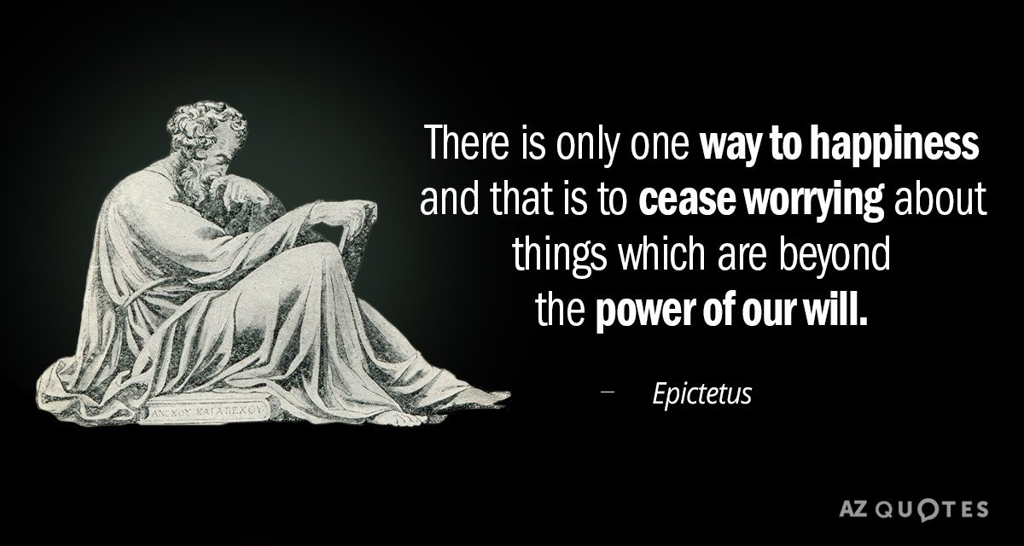

Slide 6
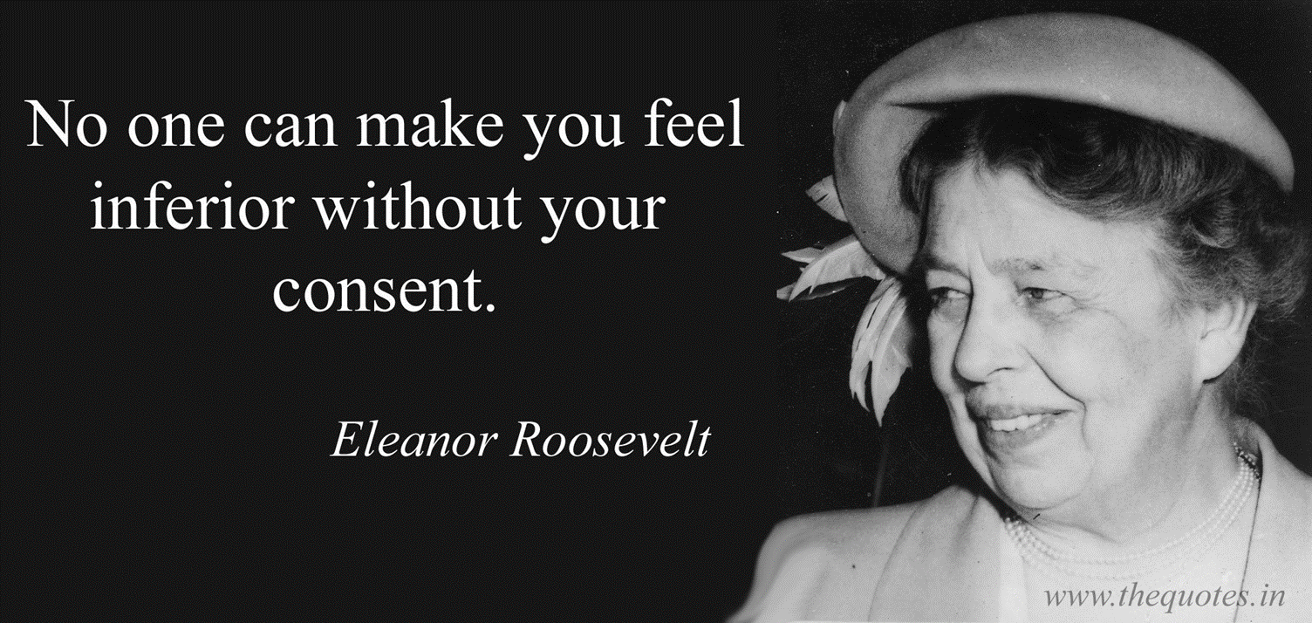
Beware of Social Media

Slide 7
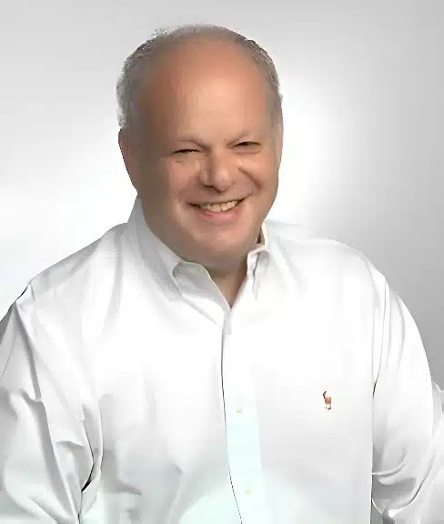
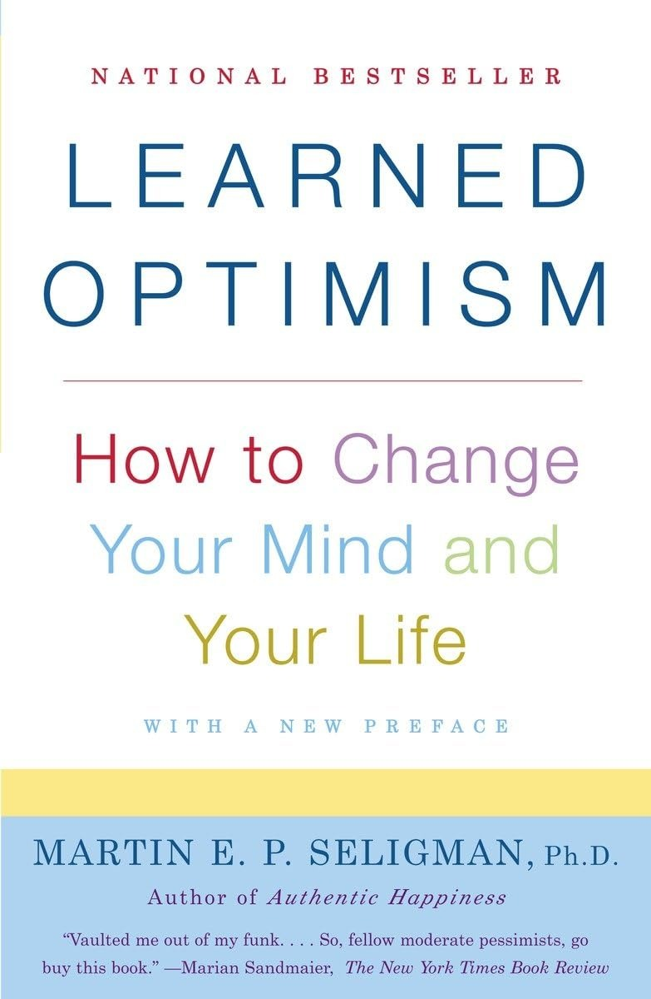
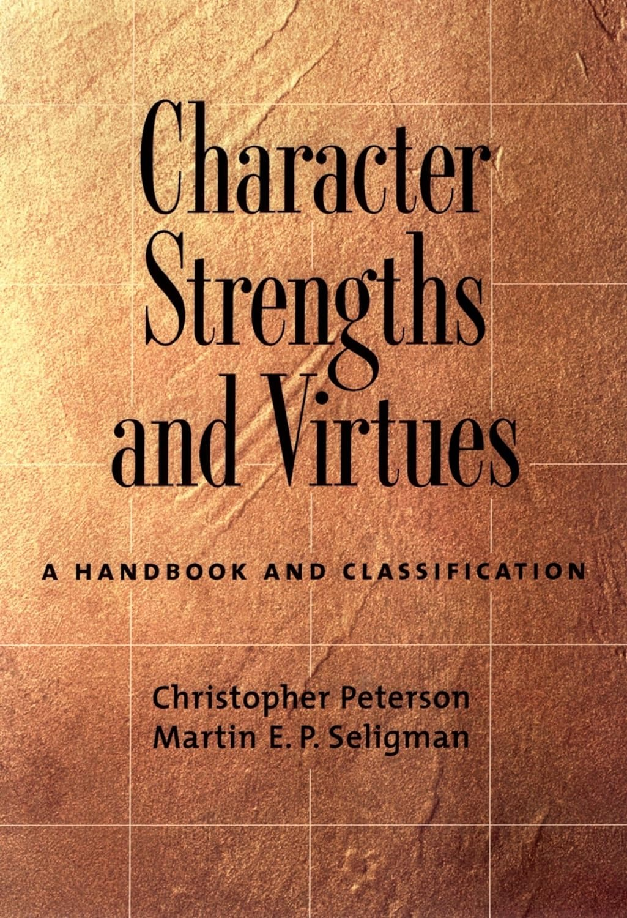
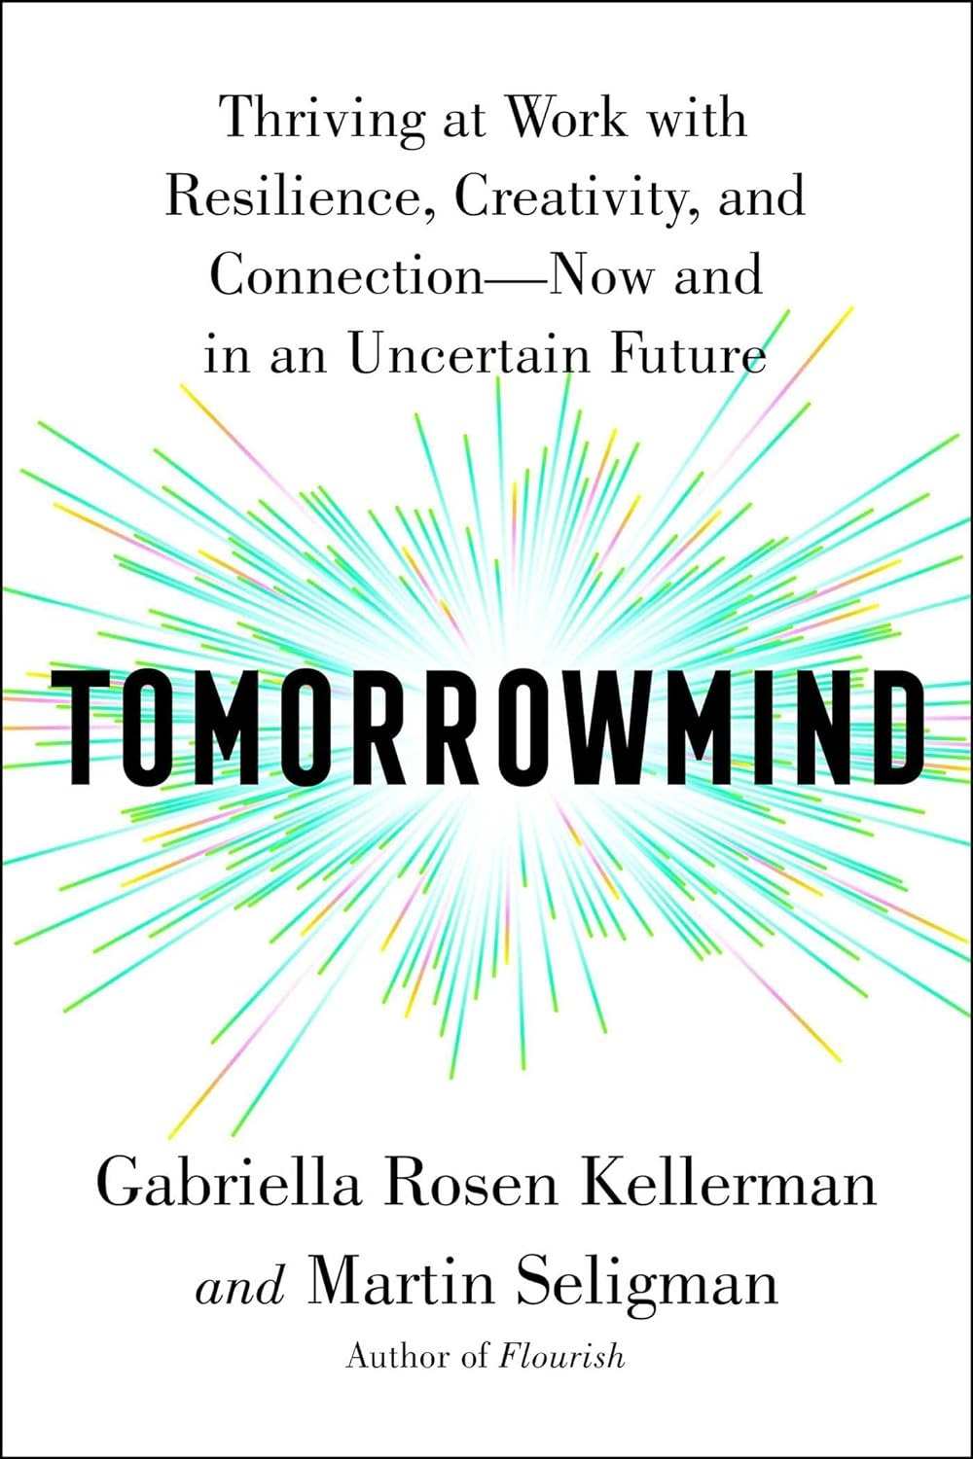
Marty Seligman The Founding Father of Positive Psychology
Notes:
1990 - Optimism
2002 - Happiness
2004 - VIA
2011 - Flourish

Slide 8
Colin Powell on Optimism
“Perpetual optimism is a force multiplier. I am talking about a gung-ho attitude that says 'we can change things here, we can achieve awesome goals, we can be the best. 'Spare me the grim litany of the 'realist;' give me the unrealistic aspirations of the optimist any day.”
Notes:
What is Seligman's theory of happiness?
This vision of happiness combines the virtue ethics of Confucius, Mencius and Aristotle with modern psychological theories of motivation. Seligman's conclusion is that happiness has three dimensions that can be cultivated: the Pleasant Life, the Good Life, and the Meaningful Life.
https://www.pursuit-of-happiness.org/history-of-happiness/martin-seligman-psychology/
Seligman Flourish and Perma explanatory style VIA Emails.
Epictetus
Brooks Arthur and David
Podcasts - Yale Russo
Habits - Rubin
Single tasking - Flow
Balance (Wheel) imbalance at the right time.
Book Summary Build the Life you want:
That means creating four sturdy pillars that will elevate you, every single day. What are those pillars? Family, friends, meaningful work, and spirituality.
What makes humans thrive
Human thriving often involves a combination of factors such as strong social connections, a sense of purpose, good physical and mental health, and opportunities for personal growth. It varies for each individual.
Thriving individuals often cultivate habits like maintaining a healthy routine, setting goals, practicing gratitude, engaging in regular exercise, fostering positive relationships, seeking personal development, and prioritizing self-care. These habits contribute to a balanced and fulfilling life.
An effective morning routine for thriving usually includes elements like:
Early Wake-up: Providing ample time for a calm start.
Hydration: Drinking water to rehydrate after sleep.
Physical Activity: Incorporating exercise for energy and well-being.
Mindfulness or Meditation: Promoting mental clarity and focus.
Nutritious Breakfast: Fueling the body with a balanced meal.
Goal Setting: Planning tasks for the day ahead.
Positive Affirmations: Cultivating a positive mindset.
Learning or Reading: Stimulating the mind with new information.
Customizing these components based on personal preferences and priorities can enhance the effectiveness of the morning routine.

Slide 9
POWELL’S LESSON #12 "Perpetual optimism is a force multiplier."
The ripple effect of a leader's enthusiasm and optimism is awesome. So is the impact of cynicism and pessimism. Leaders who whine and blame engender those same behaviors among their colleagues. I am not talking about stoically accepting organizational stupidity and performance incompetence with a "what, me worry?" smile. I am talking about a gung-ho attitude that says "we can change things here, we can achieve awesome goals, we can be the best." Spare me the grim litany of the "realist," give me the unrealistic aspirations of the optimist any day.

Slide 10
Optimism
Definition: The ability to look at the brighter side of life and to maintain a positive attitude, even in the face of adversity.
Assumes a measure of hope in one’s approach to life.
Not related to external circumstance – strictly an inner resource; Related to self-talk.
Not viewing life through “rose colored glasses”; Not “rah, rah”.

Slide 11
Learned Optimism
Three factors of “explanatory style”:
Permanence –
Temporary vs Permanent
Pervasiveness –
Specific vs Universal
Personalization –
External vs Internal
Notes:
Explanatory style is a psychological attribute that indicates how people explain to themselves why they experience a particular event, either positive or negative. Psychologists have identified three components in explanatory style:
Personal. This involves how one explains where the cause of an event arises. People experiencing events may see themselves as the cause; that is, they have internalised the cause for the event. Example: "I always forget to make that turn" (internal) as opposed to "That turn can sure sneak up on you" (external).
Permanent. This involves how one explains the extent of the cause. People may see the situation as unchangeable, e.g., "I always lose my keys" or "I never forget a face".
Pervasive. This involves how one explains the extent of the effects. People may see the situation as affecting all aspects of life, e.g., "I can't do anything right" or "Everything I touch seems to turn to gold".
People who generally tend to blame themselves for negative events, believe that such events will continue indefinitely, and let such events affect many aspects of their lives display what is called a pessimistic explanatory style. Conversely, people who generally tend to blame others for negative events, believe that such events will end soon, and do not let such events affect too many aspects of their lives display what is called an optimistic explanatory style.

Slide 12
Website (on MS Teams): https://www.viacharacter.org/survey/account/register

Slide 13
Charlie’s Highest VIA Values:

Slide 14
Charlie’s Lowest VIA Values:

Slide 16
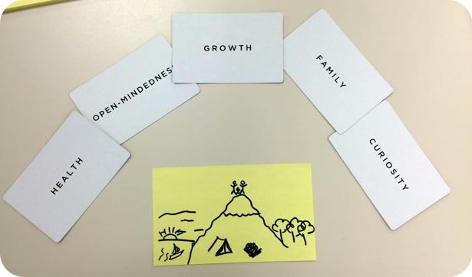

Slide 17
Framework for Thriving - P.E.R.M.A.
Positive emotion—Can only be assessed subjectively
Engagement—Like positive emotion, can only be measured through subjective means. See also “Flow”
Relationships—The presence of friends, family, intimacy, or connection
Meaning (later added Mattering)—Belonging to and serving something bigger than oneself
Achievement—Challenges that are met, accomplishment that is pursued even when it brings no positive emotion, no meaning, and nothing in the way of positive relationships.

Slide 18
Framework for Thriving - P.E.R.M.A.
Positive emotion—Can only be assessed subjectively
Engagement—Like positive emotion, can only be measured through subjective means. See also “Flow”
Relationships—The presence of friends, family, intimacy, or connection
Meaning (later added Mattering)—Belonging to and serving something bigger than oneself
Achievement—Challenges that are met, accomplishment that is pursued even when it brings no positive emotion, no meaning, and nothing in the way of positive relationships.

Slide 19
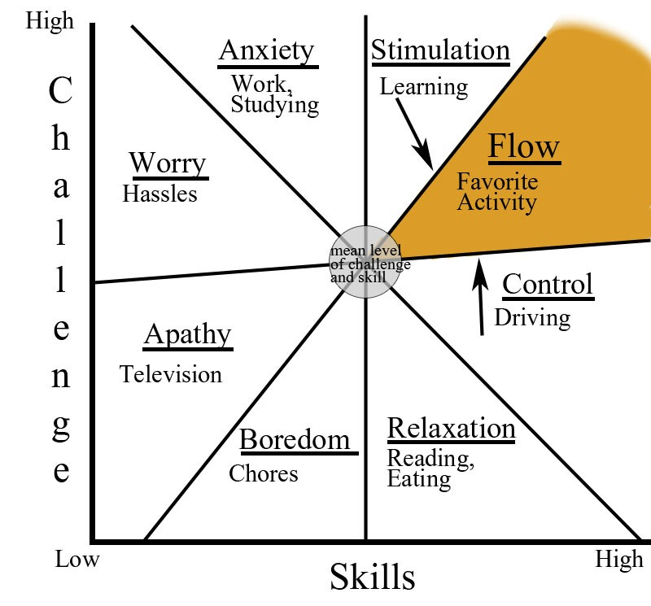
Mihaly Czikszentmihalyi
Notes:
The Science of Happiness, the scientific study of “what makes happy people happy,” was arguably launched by Mihaly Czikszentmihalyi in the late 1980’s.
Czikszentmihalyi pioneered the “Experience Sampling Method” to discover what he called the “psychology of optimal experience,” and specifically, the experience of Flow.
The Science of Happiness is now picking up speed, with scientists from around the globe exploring the neuroscience of happiness as well as the psychology of well-being.
The measurement of happiness has consequently become a major focus of the new science, with many scales presently being used depending on how “happiness” is defined.
Flow
Find your flow. If we are deeply involved in trying to reach a goal, or an activity that is challenging but well suited to our skills, we experience a joyful state called “flow.” Many kinds of activities, such as sports, playing an instrument, or teaching, can produce the experience of flow. According to Mihaly Csikszentmihalyi, a pioneer of the scientific study of happiness, flow is a type of intrinsic motivation. In his words, “you do what you’re doing primarily because you like what you’re doing. If you learn only for external, extrinsic reasons, you will probably forget it as soon as you are no longer forced to remember what you want to do…
Single Tasking
Attention -

Slide 20
Framework for Thriving - P.E.R.M.A.
Positive emotion—Can only be assessed subjectively
Engagement—Like positive emotion, can only be measured through subjective means. See also “Flow”
Relationships—The presence of friends, family, intimacy, or connection
Meaning (later added Mattering)—Belonging to and serving something bigger than oneself
Achievement—Challenges that are met, accomplishment that is pursued even when it brings no positive emotion, no meaning, and nothing in the way of positive relationships.

Slide 21
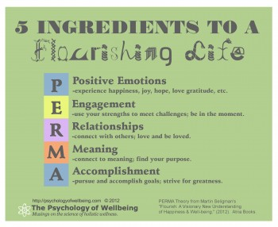
Positive Psychology
and Happiness

Slide 22
Notes:
Live a good life. If there are gods and they are just, then they will not care how devout you have been, but will welcome you based on the virtues you have lived by. If there are gods, but unjust, then you should not want to worship them. If there are no gods, then you will be gone, but will have lived a noble life that will live on in the memories of your loved ones.
Marcus Aurelius

Slide 23
Emotional Contagion – Happiness
"Happiness is when what you think, what you say, and what you do are in harmony."
– Mohandas Gandhi
“ Most folks are about as happy as they make up their minds to be.”
– Abraham Lincoln

Slide 24
Creating four sturdy pillars that will elevate you, every single day.
Family
Friends
Meaningful work
Spirituality.
Notes:
What is Seligman's theory of happiness?
This vision of happiness combines the virtue ethics of Confucius, Mencius and Aristotle with modern psychological theories of motivation. Seligman's conclusion is that happiness has three dimensions that can be cultivated: the Pleasant Life, the Good Life, and the Meaningful Life.
https://www.pursuit-of-happiness.org/history-of-happiness/martin-seligman-psychology/

Slide 25
7 THINGS YOU NEED TO THRIVE
Positive perspective: “I see the good in the future.”
Religiosity and spirituality: “I am connected with the universe in a meaningful way.”
Proactive personality: “I try to challenge myself.”
Motivation: “I am motivated to grow.”
Knowledge and learning: “I learn, therefore I know.”
Psychological resilience: “I overcome, rise up, and benefit from my struggles.”
Social competence: “It matters that I connect with others.”
Source: DR. RYAN NIEMIEC https://www.viacharacter.org/topics/articles/you-need-these-7-things-to-thrive-research-say
Notes:
Chris Peterson - manual of the sanities. Via. POS character traits. 24. Life goes better when you use strengths more. AuthenticHappiness.org
Use the stuff you like to overcome the stuff you don’t like.
Post traumatic growth
https://digitalcommons.unl.edu/cgi/viewcontent.cgi?article=1001&context=pdharms
7 THINGS YOU NEED TO THRIVE DR. RYAN NIEMIEC
1. Positive perspective: “I see the good in the future.” Research shows that having hopeful future expectations, an optimistic attitude, and positive views of your future are linked with greater thriving. This approach helps you cope with stress and adversity by sticking with activities or tasks rather than quitting or avoiding.
Character strengths: The central strength here is hope, which means to look positively toward the future, to set your goals, and to feel confident you can reach them. Researchers also link this to being honest about one’s values. Honesty might be considered a secondary character strength here, meaning you have integrity with your values, practice what you preach, and are authentic along the journey forward.
2. Religiosity and spirituality: “I am connected with the universe in a meaningful way.” For some people, religious coping, faith, a relationship with a higher power, and having a spiritual community are connected with thriving. Other research has shown the importance of practicing one’s religion/spirituality, as opposed to merely having a religion.
Character strengths: The strength of spirituality is broadly viewed as having a sense of meaning and purpose in life, which may or may not include formal religion. Personal practices such as meditation and prayer, spending time in nature, and reflecting on the universe are sources of spiritual sustenance for many. When this is connected with other people in community, other strengths emerge such as gratitude, and the gateway to thriving may widen further.
3. Proactive personality: “I try to challenge myself.” Proactive people seek out opportunities to be challenged. This is an internal desire you feel when you want to pursue something and to challenge yourself. One example found in research is teachers who engage in purposeful career decision-making; they are more likely to thrive.
Character strengths: Facing challenges and obstacles is the work of the bravery and perseverance strengths. In addition, I have observed that when I am proactive in pursuing a new work project, I tap into my zest strength while maintaining levels of self-regulation strength to take on the right task and not take on too much. No doubt when you are being proactive you are using more than one character strength in that effort.
4. Motivation: “I am motivated to grow.” Research shows people are motivated by their naturally occurring strengths, talents, and interests. These serve as sparks for fueling interest, growth, and learning. Thriving in the workplace is connected with work that is meaningful.
Character strengths: Curiosity and love of learning are central to our pursuit of knowledge, ideas, and the development of new skills. Individuals can turn to their highest strengths–signature strengths–as a central source of personal motivation to take action in relationships, work, or play.
5. Knowledge and learning: “I learn, therefore I know.” Research shows the desire and commitment to learning is important to thriving not just for certain people but across groups of people.
Character strengths: Here researchers suggest a number of strengths that have been found to support thriving under hardship in academic and vocational domains. These include creativity, perspective, appreciation of excellence, and especially love of learning.
6. Psychological resilience: “I overcome, rise up, and benefit from my struggles.” When stress and adversity arise, those who thrive are able to be flexible and adaptable and even benefit from the problem. The idea here is to move beyond surviving to thriving. Extra workloads, colleague difficulties, new demands–these become sources not to overcome and “ride out” but to benefit from.
Character strengths: What helps you become more resilient? In researching this area I’ve found links between all 24 character strengths and resilience. The strength with the most immediate resonance would be perseverance–the capacity to keep going, to overcome obstacles. Other important strengths include hope, gratitude, forgiveness, spirituality, curiosity, and kindness.
7. Social competence: “It matters that I connect with others.” An important enabler of thriving is to access others, connect with them, and benefit from their social support. The building of social competence matters here, such as skills of peaceful conflict resolution, awareness and appreciation of other cultures, and interpersonal skills.
Character strengths: The strength of social intelligence helps us assess situations and people, and respond appropriately. It serves us in sensing what is going on within both ourselves and others and to share those feelings in the spirit of cooperation or connection. Also important here is the strength of love which involves bonding with others, being warm and genuine with them, and giving/receiving that caring support. The justice-oriented character strengths of leadership, fairness, and teamwork are important for building social competence.
References
Brown, D. J., Arnold, R., Fletcher, D., & Standage, M. (2017). Human thriving A conceptual debate and literature review. European Psychologist, 22(3), 167–179. DOI: 10.1027/1016-9040/a000294

Slide 26
Framework for a “Tomorrowmind” P.R.I.S.M.
Prospection (P): The uniquely human ability to imagine and plan for disparate futures, so that we are in a greater state of empowerment and readiness for whatever is to come.
Resilience (R): Bouncing back from change unharmed – or, better yet, growing stronger through adversity.
Innovation and creativity (I): The ability to generate novel, surprising, and useful solutions to problems. We can cultivate this ability at all levels.
Social support, by way of rapid rapport (S): The ability to build trust quickly across interpersonal difference and geographic distance, with both customers and colleagues
Mattering and meaning (M): The motivation to fuel the work of navigating each successive chapter of change.
Notes:
Five key skills are critical to flourishing at work today and are summarized by the acronym PRISM:
Prospection (P): The uniquely human ability to imagine and plan for disparate futures, so that we are in a greater state of empowerment and readiness for whatever is to come.
Resilience (R): Bouncing back from change unharmed – or, better yet, growing stronger through adversity.
Innovation and creativity (I): The ability to generate novel, surprising, and useful solutions to problems. We can cultivate this ability at all levels.
Social support, by way of rapid rapport (S): The ability to build trust quickly across interpersonal difference and geographic distance, with both customers and colleagues
Mattering and meaning (M): The motivation to fuel the work of navigating each successive chapter of change.
All of these skills can be developed. And leaders have a critical role to play in helping to instill them in the workforce. Organizations that focus their talent efforts on developing these meta-skills will be more agile, successful, and future-proof.
We’re thrilled that the science underpinning this research, including details on how to build these skills, is now available for a general audience in Tomorrowmind. We also include our recommendations on how corporations can sustainably tackle this work through a more holistic approach to human capital management.

Slide 27
Habits for Thriving

Slide 28
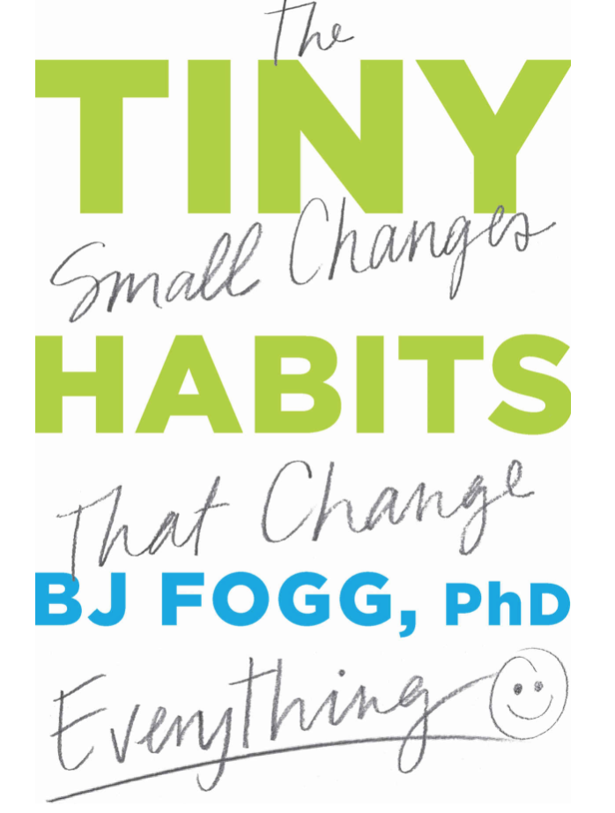
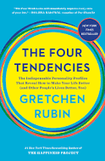
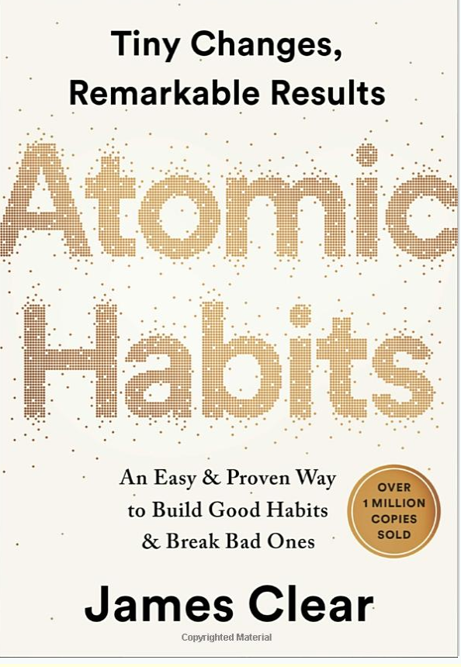
Habits for Thriving
Notes:
Start small
Customize for your personality
Create a system to make it easy

Slide 29
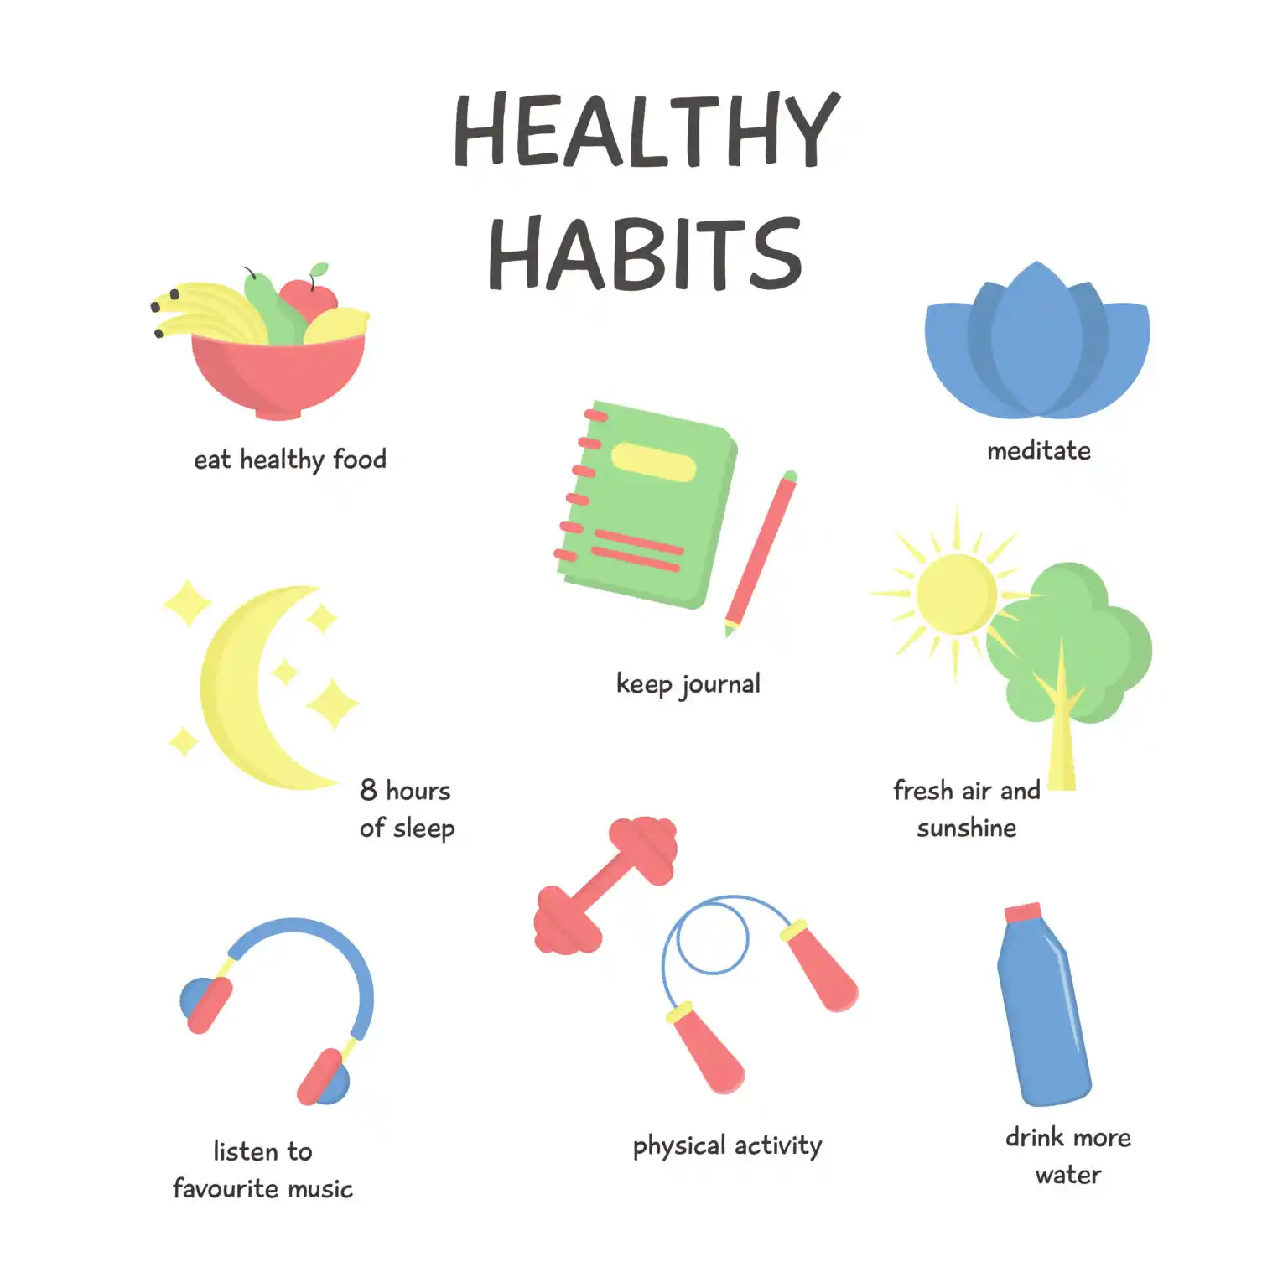
Habits for Thriving
Setting goals
Practicing gratitude
Engaging in regular exercise
Fostering positive relationships
Seeking personal development
Prioritizing self-care
Maintaining a healthy routine (Morning/Evening Routines?)
Notes:
Maintaining a healthy routine
Setting goals,
Practicing gratitude,
Engaging in regular exercise,
Fostering positive relationships,
Seeking personal development
Prioritizing self-care.
An effective morning routine for thriving usually includes elements like:
Early Wake-up: Providing ample time for a calm start.
Hydration: Drinking water to rehydrate after sleep.
Physical Activity: Incorporating exercise for energy and well-being.
Mindfulness or Meditation: Promoting mental clarity and focus.
Nutritious Breakfast: Fueling the body with a balanced meal.
Goal Setting: Planning tasks for the day ahead.
Positive Affirmations: Cultivating a positive mindset.
Learning or Reading: Stimulating the mind with new information.
Customizing these components based on personal preferences and priorities can enhance the effectiveness of the morning routine.

Slide 30
What are some personal and organizational Best Practices and Habits?? Please add your ideas to the chat.
Notes:
U.S. COAST GUARD ACADEMY
Wellness & Resilience Day
11 January 2024
CGA’s most valuable asset is the professional Community it creates to meet the vital mission of cultivating service-ready officers. The work this Community undertakes is difficult, dynamic, and unrelenting. The Corps of Cadets and CGA Community are in need of rejuvenation and healing. Wellness & Resilience Day creates an opportunity for the CGA Community to pause and focus on health and wellness while building capacity for individual and Community resilience.
Time Topic/Event
0745-0755 Welcome Remarks by RADM Michael J. Johnston, Superintendent, Coast Guard Academy
0755-0805 Introduction to Primary Prevention by Dr. Garland-Jackson, USCG’s Primary Prevention Program Manager
0805-0900 Stories of Stress - Modeling vulnerability & creating opportunity for empathy, these monologues create shared moments of connection for members of the CGA Community by members of the CGA Community.
0915-1130 Meeting People Where They Are:
Workshop sessions for conducting mental health pulse checks & seeking proper care as well as having a healthy relationship with alcohol or other releases.
1145-1245 Lunch and The Role of Nutrition Workshop
1300-1515 Facets of Wellbeing
Workshop session offerings on physical & sleep, mental & emotional, relational/familial & social, spiritual & religious, and financial aspects of wellbeing.
1530-1630 Afternoon Keynote Speaker – A presentation to tie everything together -- health, wellness, post-traumatic growth, & paths toward balance/happiness --
1630-1645 Closing Remarks by RADM Michael J. Johnston, Superintendent, Coast Guard Academy

Slide 31
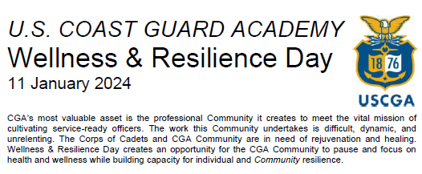
USCG Best Practices
Notes:
U.S. COAST GUARD ACADEMY
Wellness & Resilience Day
11 January 2024
CGA’s most valuable asset is the professional Community it creates to meet the vital mission of cultivating service-ready officers. The work this Community undertakes is difficult, dynamic, and unrelenting. The Corps of Cadets and CGA Community are in need of rejuvenation and healing. Wellness & Resilience Day creates an opportunity for the CGA Community to pause and focus on health and wellness while building capacity for individual and Community resilience.
Time Topic/Event
0745-0755 Welcome Remarks by RADM Michael J. Johnston, Superintendent, Coast Guard Academy
0755-0805 Introduction to Primary Prevention by Dr. Garland-Jackson, USCG’s Primary Prevention Program Manager
0805-0900 Stories of Stress - Modeling vulnerability & creating opportunity for empathy, these monologues create shared moments of connection for members of the CGA Community by members of the CGA Community.
0915-1130 Meeting People Where They Are:
Workshop sessions for conducting mental health pulse checks & seeking proper care as well as having a healthy relationship with alcohol or other releases.
1145-1245 Lunch and The Role of Nutrition Workshop
1300-1515 Facets of Wellbeing
Workshop session offerings on physical & sleep, mental & emotional, relational/familial & social, spiritual & religious, and financial aspects of wellbeing.
1530-1630 Afternoon Keynote Speaker – A presentation to tie everything together -- health, wellness, post-traumatic growth, & paths toward balance/happiness --
1630-1645 Closing Remarks by RADM Michael J. Johnston, Superintendent, Coast Guard Academy

Slide 32
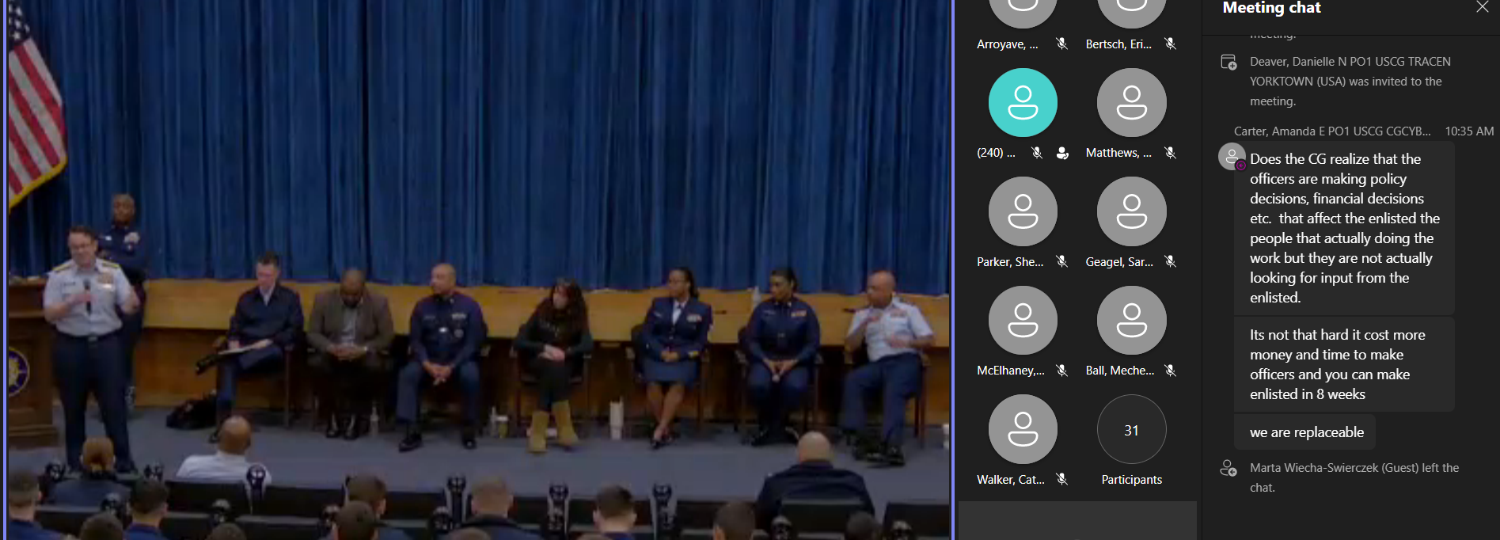
USCG Best Practices - EPIC (Enlisted Professionals In Connection)
Notes:
On behalf of Enlisted Professionals In Connection (EPIC), please accept this invitation to a Martin Luther King Jr. Day Town Hall at TRACEN Yorktown.
WHAT: The newly established Coast Guard Affinity Group EPIC (Enlisted Professionals In Connection) will be hosting its annual Town Hall in conjunction with the kick-off to the MLK basketball tournament (attached ALCOAST).
WHY: EPIC Town Hall 2024 – “What’s your Coast Guard plight: How to overcome”? This year’s theme is to talk to members about the issues being faced within today’s Coast Guard. The panel member’s selected are there to provide resources and guidance on how to navigate through the difficult moments.
WHERE: Training Center Yorktown, Washington Auditorium

Slide 33
Human Thriving Factors
Social connections
Purpose / Meaning
Good Health (Physical and Mental)
Personal growth
Others ???
Notes:
What is Seligman's theory of happiness?
This vision of happiness combines the virtue ethics of Confucius, Mencius and Aristotle with modern psychological theories of motivation. Seligman's conclusion is that happiness has three dimensions that can be cultivated: the Pleasant Life, the Good Life, and the Meaningful Life.
https://www.pursuit-of-happiness.org/history-of-happiness/martin-seligman-psychology/
Seligman Flourish and Perma explanatory style VIA Emails.
Epictetus
Brooks Arthur and David
Podcasts - Yale Russo
Habits - Rubin
Single tasking - Flow
Balance (Wheel) imbalance at the right time.
Book Summary Build the Life you want:
That means creating four sturdy pillars that will elevate you, every single day. What are those pillars? Family, friends, meaningful work, and spirituality.
What makes humans thrive
Human thriving often involves a combination of factors such as strong social connections, a sense of purpose, good physical and mental health, and opportunities for personal growth. It varies for each individual.
Thriving individuals often cultivate habits like maintaining a healthy routine, setting goals, practicing gratitude, engaging in regular exercise, fostering positive relationships, seeking personal development, and prioritizing self-care. These habits contribute to a balanced and fulfilling life.
An effective morning routine for thriving usually includes elements like:
Early Wake-up: Providing ample time for a calm start.
Hydration: Drinking water to rehydrate after sleep.
Physical Activity: Incorporating exercise for energy and well-being.
Mindfulness or Meditation: Promoting mental clarity and focus.
Nutritious Breakfast: Fueling the body with a balanced meal.
Goal Setting: Planning tasks for the day ahead.
Positive Affirmations: Cultivating a positive mindset.
Learning or Reading: Stimulating the mind with new information.
Customizing these components based on personal preferences and priorities can enhance the effectiveness of the morning routine.
What is human thriving?
Specifically, human thriving was defined as the joint experience of development and success, which can be realized through effective holistic functioning and observed through the experience of a high-level of well-being and a perceived high-level of performance.
How does a person thrive?
The strength with the most immediate resonance would be perseverance–the capacity to keep going, to overcome obstacles. Other important strengths include hope, gratitude, forgiveness, spirituality, curiosity, and kindness

Slide 34
Wrap-up Q&A

